Slide 1
A Comprehensive Introduction to Artificial Intelligence and Blockchain
Andrei Tour, February 2020
Copyright 2020 Andrei Tour

Slide 2
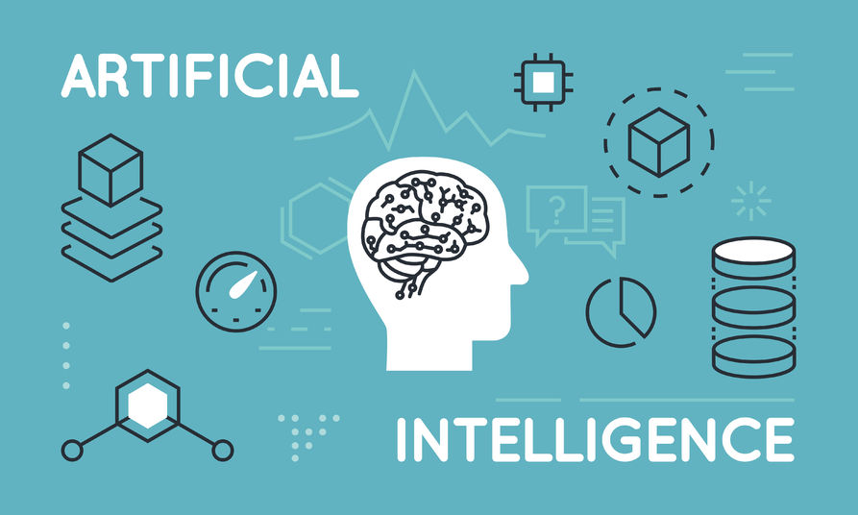
Learning Objectives
The main purpose of the course:
To develop a “big picture” view on AI that can help students make more informed personal and professional decisions related to challenges and opportunities the latest AI trends represent.
At the end of the course students will have a clear picture regarding:
What is AI ?
What are AI use cases?
How does AI work?
How to implement an AI project?
What are AI impacts?
Copyright 2020 Andrei Tour

Slide 3
Part 1: What is AI ?
Learning Outcomes:
At the end of this session students should be able to
Provide definition of the term AI and understand its meaning.
Explain the difference between “Narrow AI” and “Generic AI”.
Discuss possible AI goals
Describe relationship among Data Science, AI and Machine Learning.
Identify important milestones in AI history.
Copyright 2020 Andrei Tour

Slide 4

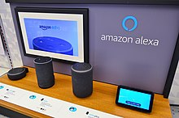
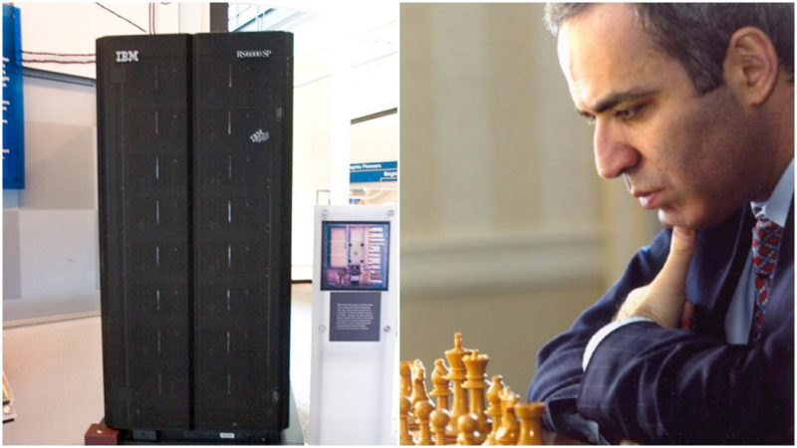
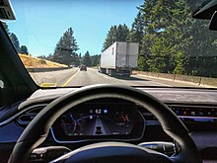



What is AI: Select AI Examples
Select examples that are “AI examples”. Possible answers : “yes”, “no”, “not sure”.
# | Example
1 | Sydney Metro – a fully automated rapid transit system that opened on 26 May 2019, it runs from Tallawong to Chatswood.
2 | Amazon Alexa – a virtual assistant developed by Amazon, first used in the Amazon Echo smart speakers.
3 | IBM Deep Blue versus Garry Kasparov was a pair of six-game chess matches between world chess champion Garry Kasparov and an IBM supercomputer Deep Blue.
4 | Tesla Autopilot is an advanced driver-assistance system feature offered by Tesla that has lane-centering, adaptive cruise control, self-parking functions.
5 | AlphaGo versus Fan Hui was a five-game Go match between European champion Fan Hui, and AlphaGo, a computer Go program developed by Google DeepMind.
6 | Unmanned aerial vehicle (UAV), commonly known as a drone, is an aircraft without a human pilot on board.
7 | UnionPay facial recognition payment service launched at the World Internet Conference in Wuzhen (Chine) in October 2019.
Copyright 2020 Andrei Tour

Slide 5
What is AI: Select AI Examples
Select examples that are “AI examples”. Possible answers : “yes”, “no”, “not sure”.
# | Example
1 | Sydney Metro – a fully automated rapid transit system that opened on 26 May 2019, it runs from Tallawong to Chatswood. |  | No
2 | Amazon Alexa – a virtual assistant developed by Amazon, first used in the Amazon Echo smart speakers. |  | Yes
3 | IBM Deep Blue versus Garry Kasparov was a pair of six-game chess matches between world chess champion Garry Kasparov and an IBM supercomputer Deep Blue. |  | No
4 | Tesla Autopilot is an advanced driver-assistance system feature offered by Tesla that has lane-centering, adaptive cruise control, self-parking functions. |  | Yes
5 | AlphaGo versus Fan Hui was a five-game Go match between European champion Fan Hui, and AlphaGo, a computer Go program developed by Google DeepMind. |  | Yes
6 | Unmanned aerial vehicle (UAV), commonly known as a drone, is an aircraft without a human pilot on board. |  | No
7 | UnionPay facial recognition payment service launched at the World Internet Conference in Wuzhen (Chine) in October 2019. |  | Yes
Copyright 2020 Andrei Tour

Slide 6
What is AI: Position AI in relation to people and other things
Place 3 dots (one per triangle) in positions that reflect how close or far AI is to other things and people.
Routine
Complex
Human
Variable
Simple
Physical
Digital
Copyright 2020 Andrei Tour

Slide 7
What is AI: Position AI in relation to people and other things
Place 3 dots (one per triangle) in positions that reflect how close or far AI is to other things and people.
Routine
Technique
AI
Human
AI
Variable
Magic
AI
Physical
Digital
Copyright 2020 Andrei Tour

Slide 8
What is AI: AI Term Deconstruction
A good way to understand the meaning of something is to find its opposites.
What are opposites of “Artificial” ?
What is the difference between “Artificial” and its opposites?
What are opposites of “Intelligence” ?
What is the difference between “Intelligence” and its opposites?
What “Artificial Intelligence” is not ?
Copyright 2020 Andrei Tour

Slide 9
What is AI: AI Term Deconstruction
A good way to understand the meaning of something is to find its opposites.
What are opposites of “Artificial” ?
“Natural”
What is the difference between “Artificial” and its opposites?
How do we know if something is “Artificial” or “Natural” ?
What are opposites of “Intelligence” ?
“Stupidity”
What is the difference between “Intelligence” and it opposites?
How do we know if some behaviour is “Intelligent” or “Stupid” ?
What “Artificial Intelligence” is not ?
“Natural Intelligence”, “Artificial Stupidity” …
Copyright 2020 Andrei Tour

Slide 10
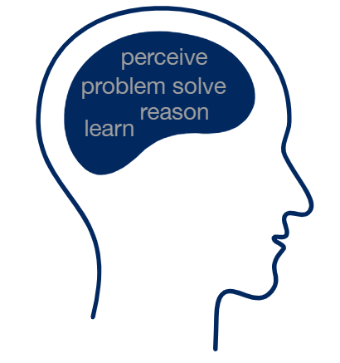
What is AI: Definitions
There is no universally accepted definition of ‘artificial intelligence’ because the meaning of ‘intelligence’ is arbitrary.
AI as a type of technology:
The ability of a machine to perform cognitive functions we associate with human minds, such as perceiving, reasoning, learning, interacting with the environment, problem solving, and even exercising creativity.
[https://www.mckinsey.com/business-functions/mckinsey-analytics/our-insights/an-executives-guide-to-ai, accessed 4 Jan 2020]
AI as a field of science:
the study of “intelligent agents”: any device that perceives its environment and takes actions that maximize its chance of successfully achieving its goals.
[Poole, Mackworth & Goebel 1998, p. 1]
Tesler’s Theorem (also known as AI effect):
Intelligence is whatever machines haven't done yet.
Commonly quoted as “AI is whatever hasn’t been done yet.” [Larry Tesler, ca. 1970]
Copyright 2020 Andrei Tour

Slide 11
What is AI?: Goals for AI
Another approach to answering the question “What is AI ?” is to think about possible AI goals.
 | Human-Based | Ideal Rationality
Behaviour-Based | Systems that act like humans | Systems that act rationally
Reasoning-Based | Systems that think like humans | Systems that think rationally
4 possible goals for AI according to AIMA (Russell & Norvig 2002)
Our Focus
Copyright 2020 Andrei Tour

Slide 12
What is AI: Narrow and General AI
A separation between AI as we know it today (also called “narrow AI”) and a future state of AI (“general AI”) that can apply intelligence to any problem.
Our Focus
AI
ANI
(Artificial Narrow Intelligence)
AGI
(Artificial General Intelligence)
ANI, or “weak AI”, is defined as “a specific type of artificial intelligence in which a technology outperforms humans in some very narrowly defined task. Narrow AI focuses on a single subset of cognitive abilities.”
AGI, or “strong AI,” allows a machine to apply knowledge and skills in different contexts. This more closely mirrors human intelligence by providing opportunities for autonomous learning and problem-solving.
Examples:
Self-driving cars;
Customer service bots, Email spam filters.
Examples:
R2D2 robot from the “Star Wars” movie.
Copyright 2020 Andrei Tour

Slide 13
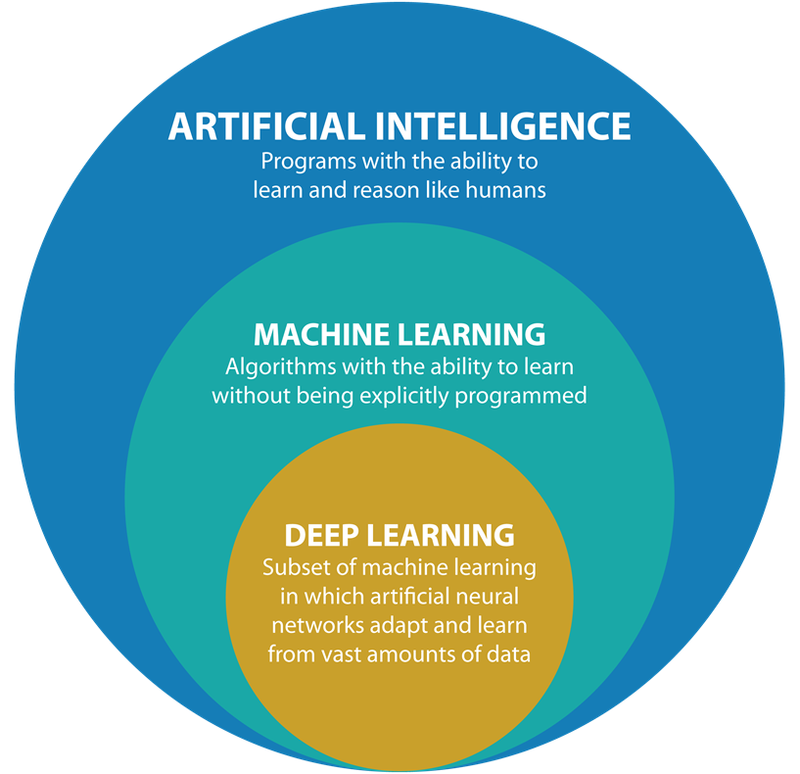
What is AI: AI, ML, and DL
A key feature of AI technologies is implicit programming, where computers learn on their own, as opposed to explicit programming, where humans tell computers what to do.
The implicit programming approach to AI is called “Machine Learning” (ML).
Deal Learning (DL) is the most successful and widely used sub-type of machine learning used today.
Copyright 2020 Andrei Tour

Slide 14
What is AI: AI Timeline
The AI story is a sequence of significant milestones from 3 main AI enabling trends:
algorithmic advancements, increases in computer power and storage, and explosion of data.
2020
AI is part of almost every software for business management
2019
UnionPay facial recognition payment service launched in China
2017
Google introduces TPU that speeds machine-learning processes
2014
Number of mobile devices exceeds number of humans
2012
Deep-learning system wins image-classification contest for the first time
2009
GPU used to train deep learning models more efficiently
2005
Cost of one GB of disk storage drops to $0.79 from $277 10 years earlier
2002
Amazon brings cloud storage and computing to the masses
1997
Increase in computer power drives IBM Deep Blue victory over Garry Kasparov
1991
Opening of the World Wide Web
1986
Publication of the backpropagation algorithm
1965
Birth of deep learning, and recognition of exponential growth in chip power
1958
Development of the first self-learning algorithm
1956
The field of AI research was born
Copyright 2020 Andrei Tour

Slide 15
What is AI: Scope of this Course
The field of AI has many dimensions and perspectives. To achieve better learning outcomes this course will focus on a sub-set of what is included under the AI umbrella.
In Scope
Artificial Narrow Intelligence (ANI)
Machine Learning (ML) as a technology for learning, reasoning, problem solving like humans
Out of Scope
General Artificial Intelligence (GNI)
Robots, Intelligent sensors and actuators for perceiving and acting like humans
For the rest of the course the terms AI and ML will be used interchangeably.

Slide 16
Part 2: Uses of AI
Learning Outcomes:
At the end of this session students should be able to
Provide useful intuitions for thinking about possible AI uses:
“Prediction Machine” Intuition
“One Second” Intuition
Give examples of industry applications of AI.
Understand the link between AI and other disruptive technologies:
Internet of Things
Blockchain
Identify “Hard” limitations for AI use.
Identify “Soft” limitations for AI use.

Slide 17
Uses of AI: One Task at a Time
All contemporary ML algorithms belong to the narrow AI category. They are good at only one task type. Most real life activities consist of multiple task types. Any complex job should be represented as a sequence of simple tasks. Only then AI technology application can be considered for each task separately, one task at a time.
Weekly Shopping Job
X
Cannot apply AI to the whole job
Weekly Shopping Job
AI
AI
AI
Create Shopping List
Go to Shop
Collect goods
Make Payment
Return Home
V
Can apply AI separately to some tasks involved in the job (divide and conker)

Slide 18
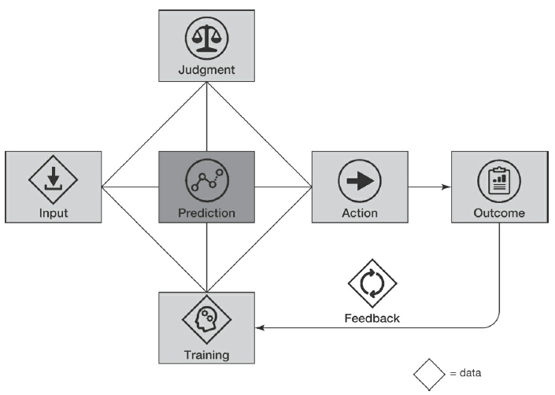
Uses of AI: “Prediction Machine” Intuition
One can think of AI algorithms as machines that make predictions. With this approach any task with a prediction element can benefit from application of AI technologies.
Application area of AI/ML algorithms as “prediction machines”
Prediction is the process of filling in missing information. Prediction takes information you have, often called “data,” and uses it to generate information you don’t have.
Prediction is only one element of a task. The other elements are 3 types of data (input, training, and feedback), judgment, action, and outcome.
AI/ML technology is valuable because it can produce better, faster, and cheaper predictions than humans can.
Anatomy of a task (Agraval, Gans, Goldfarb 2018)

Slide 19
Uses of AI: “One Second” Intuition
“Most predictions/decisions a human can do within 1 second can be automated using AI/ML technology.” [Andrew Ng]
Decision Topic | “One Second” Predictions (good for AI) | “Longer” Predictions (Not good for AI)
Text Analysis | Does an email contain spam? | What is a text meaning?
Speech recognition | What text corresponds to an audio fragment?
Language translation | What Chinese text correspond to an English text? | Which of 2 possible translations better correspond to a message conveyed by the author?
Visual Inspection | Is passport photo valid? | Is it a fake painting?
Self-driving Cars | Is it safe to continue movement? | What are intentions of an approaching pedestrian?

Slide 20
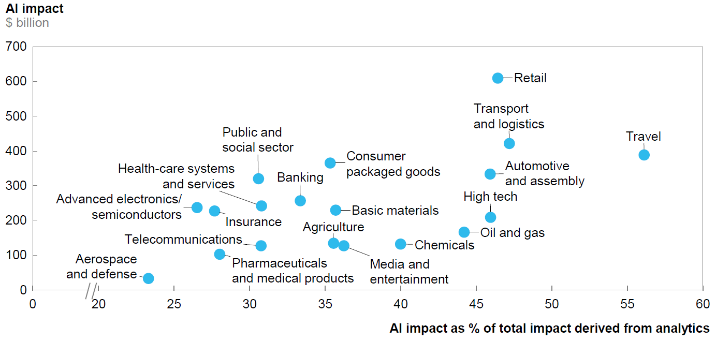
Uses of AI: Industry Value Creation
AI has the potential to create annual value across sectors totalling $3.5 trillion to $5.8 trillion, or 40 percent of the overall potential impact from all analytics techniques.
SOURCE: McKinsey Global Institute analysis

Slide 21
Uses of AI: Commercialized Basic Scenarios
Multiple industries are in early stages of AI adoption. A number of generic AI application scenarios have been commercialized and used across different industries. Today AI is part of almost every software for business management.
Scenario Category | Scenario Examples
Decision-Making: Make smarter decisions faster | Identify potential problems early on. Detect potentially offensive or unwanted content.
Language: Extract meaning from unstructured text | Help readers of all abilities comprehend text using audio and visual cues. Build natural language understanding into apps, bots and IoT devices. Detect sentiment, key phrases and named entities.
Speech: Integrate automated speech processing | Transcribe audible speech into readable, searchable text. Integrate real-time speech translation into your apps. Identify and verify the people speaking based on audio.
Vision: Identify and analyse content within images, videos and digital ink | Analyse content in images. Detect and identify people and emotions in images. Analyse the visual and audio channels of a video, and index its content.
SOURCE: Microsoft

Slide 22
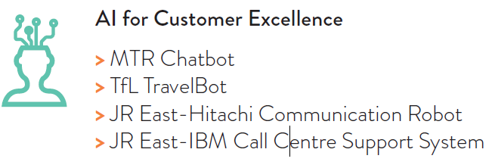
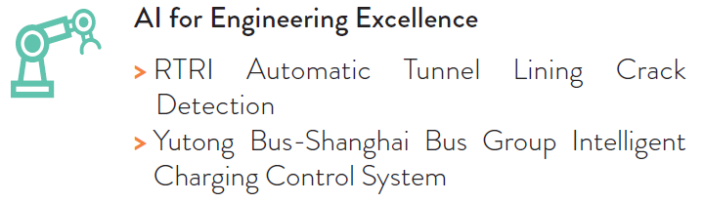
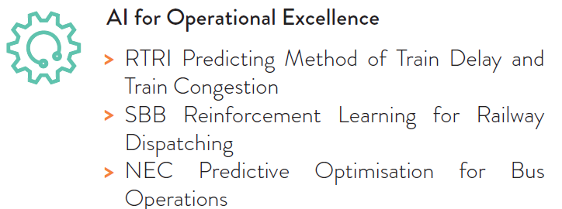
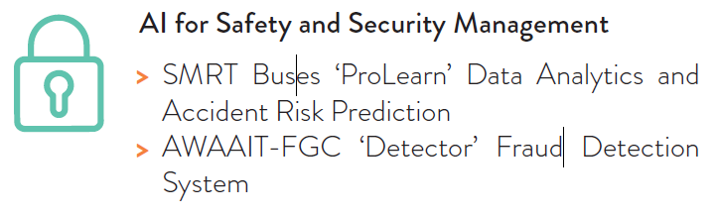
Uses of AI: Closer Look at AI in Public Transport
AI is clearly gaining traction in the public transport sector. Current AI applications in public transport have NOT been designed to replace staff. Use of AI is expected to improve financial efficiency
and uptake of public transport.
SOURCE: UITP Centre for Transport Excellence – Artificial Intelligence in Mass Public Transport Report

Slide 23
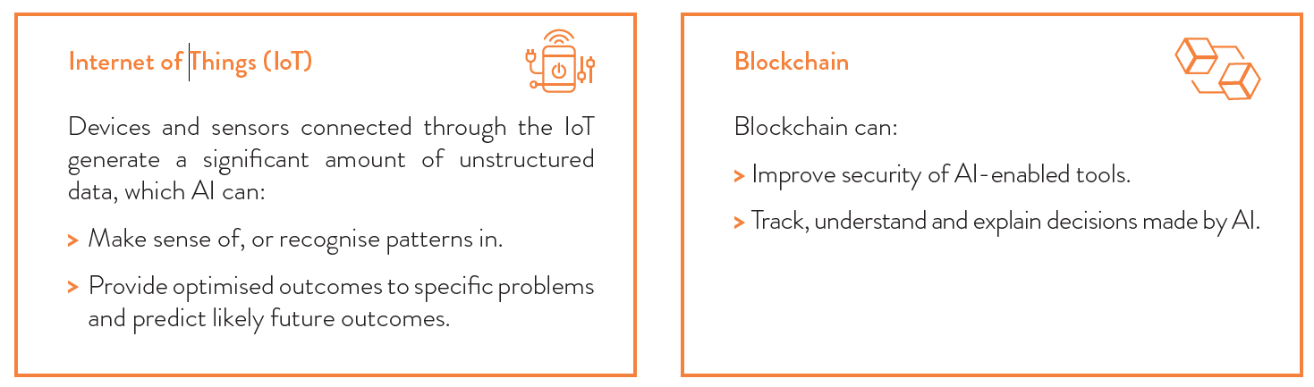
Uses of AI: Link to Internet of Things and Blockchain
Combining AI with the internet of things or blockchain can give rise to further opportunities...
SOURCE: UITP

Slide 24
Uses of AI: Realistic View
As with any new technology, there are multiple views and opinions on the topic of what AI can and cannot do, and what does it mean for the humanity. Some views are too optimistic, some are too optimistic. Most likely, the truth is somewhere in the middle.
Too optimistic view on AI capabilities
Super-intelligent AI killer robots coming, they will replace people in all aspects of human activities.
Too pessimistic view on AI capabilities
AI is just a fancy new name for same old automation technology, the current AI hype will fade away soon.
Realistic view on AI capabilities
AI cannot do everything, but it radically improves efficiency and lowers cost of predictions, and it will disrupt and transform industries.

Slide 25
Uses of AI: Hard limitations
There are some hard factors that limit effective use of AI. These factors are mostly related to the way the current AI algorithms work and what kind of inputs they need.
AI requires large amounts of data for learning ( 10,000+ data samples)
AI cannot be used to solve non-repeatable less frequent problems that do not have enough examples of solving the problem.
AI requires clear definition of the “right answer” (simple evaluation criteria)
AI cannot be used to solve fussy non-well defined problems where correctness of task outputs is not obvious , or multiple “right answers” exist.
AI requires a lot of time and computing power to learn from data (days and weeks)
AI cannot be used in situations where the definition of the “right answer” changes quickly over time, and therefore AI training has to be repeated frequently.

Slide 26
Uses of AI: Soft Limitations
There is an important role for humans to play to maximise the benefit of AI solutions. This significant contribution of people into AI success can be a source of soft constraints limiting AI effectiveness.
Artificial is not Human
AI systems need human interactions.
AI is task-specific; humans should manage the bigger picture.
AI is only a tool and enabler to unlock creative ideas.
External Constraints
AI is human resource intensive: a lot of highly skilled people are required to build and use AI.
Data-protection regulations on data ownership and usage may slow down the progress of AI.
Results produced by AI are difficult to interpret and trust.
Adversarial attacks on AI
AI cannot fix itself, it needs people to for maintenance and repairs

Slide 27
Part 3: How does AI Work
Learning Outcomes:
At the end of this session students should be able to
Explain the key difference between ML and other Computer Algorithms.
Provide intuition for the main ML approaches.
Compare main ML approaches.
Describe a typical ML pipeline.

Slide 28
How does AI work: ML vs Traditional Computing
A traditional computing machine takes data and an algorithm as inputs and executes the algorithm to produce results from the input data. ML turns this around: the inputs are data and expected results and the output is an algorithm that can produce the expected results from the data.
Traditional Computer
ML Computer
Data
Data
Results
Algorithm
Algorithm
Results
People give a computer the algorithm (step-by-step instructions) how to produce correct results.
People give a computer examples of correct and incorrect results, and the computer “learns” the algorithm itself.

Slide 29
How does AI work: 5 main Approaches to ML
There are 5 main schools of thought in ML. They are often combined to attack problems from different angles. As a result, most of the modern machine learning platform leverage algorithms from all five school of thoughts often combining them to enable robust machine learning capabilities.
School | Key Concept | Intuition
Connectionists | Neural Network | Connecting artificial neurons in a neural network similar to how natural neurons are connected in human brains.
Evolutionaries | Natural Selection | Genetic programming, which evolves computer programs in the same way as nature evolves organisms.
Analogizers | Similar Situations | Recognizing similarities between situations and thereby inferring other similarities; judging how similar two things are.
Bayesians | Uncertain Knowledge | Incorporating new evidence into existing beliefs about noise, incomplete, and contradictory information.
Symbolists | Symbolic Logic | Manipulating symbols according to rules of formal logic, in the same way as mathematicians solve equations by substituting expressions.
SOURCE: Pedro Domingos, 2015

Slide 30
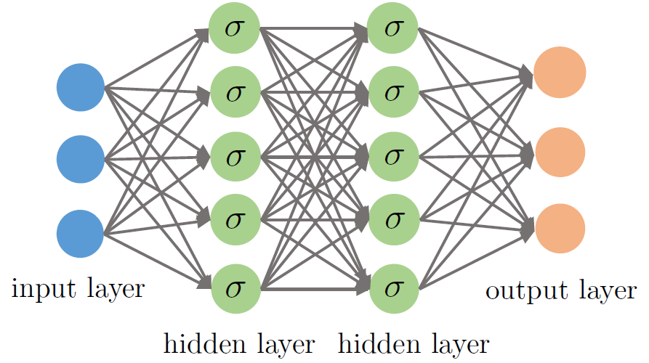
How does AI work: The Connectionists
This school of thought believes in deducing knowledge through the connections between the neurons. The connectionists focus on physics and neuroscience and believe in the reverse engineering of the brain. They believe in the back-propagation or "backward propagation of errors" algorithm to train the artificial neural networks to get the results.
Synapses with weights
Neurons with activation functions
Artificial Neural Networks with more than 1 hidden layer are called Deep Networks. Machine Learning using deep networks is called Deep Learning.

Slide 31
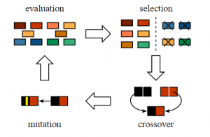
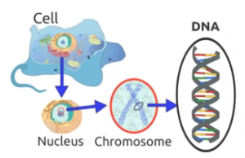
How does AI work: The Evolutionaries
The evolutionaries, draw their conclusions on the basis of genetics and evolutionary biology. Their approach is based on bringing Darwin's evolution theory into the computer sciences in form of genetic algorithms.
SOURCE: https://www.neuraldesigner.com/blog/genetic_algorithms_for_feature_selection
SOURCE: http://www.jade-cheng.com/au/coalhmm/optimization/
Start with an initial population, select parents from this population for mating. Apply crossover and mutation operators on the parents to generate new off-springs. And finally these off-springs replace the existing individuals in the population and the process repeats. In this way genetic algorithms try to mimic the human evolution to some extent.

Slide 32
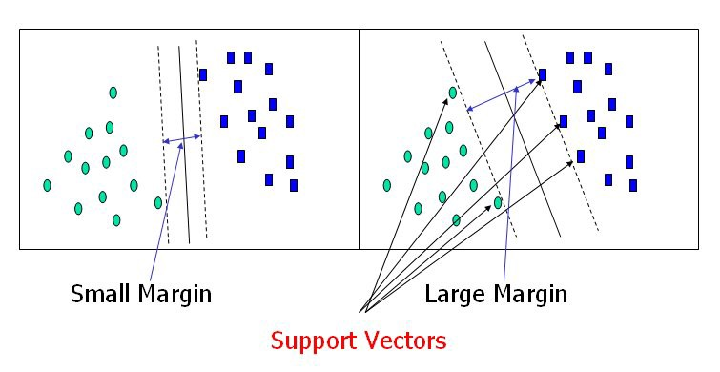
How does AI work: The Analogizers
The analogizers depend on extrapolating the similarity judgements by focusing more on psychology and mathematical optimization. The analogizers follow the “nearest neighbour" intuition stating that the more similar things are the close they are to each other and vice-versa. The product recommendations on web-sites like Amazon or movie ratings on Netflix are the most common examples of the approach. The most algorithm of this type is the “Support Vector Machine” (SVM).
To separate the two classes of data points, there are many possible hyperplanes that could be chosen. Our objective is to find a plane that has the maximum margin, i.e the maximum distance between data points of both classes. Maximizing the margin distance provides some reinforcement so that future data points can be classified with more confidence.
SOURCE: https://towardsdatascience.com/support-vector-machine-introduction-to-machine-learning-algorithms-934a444fca47

Slide 33
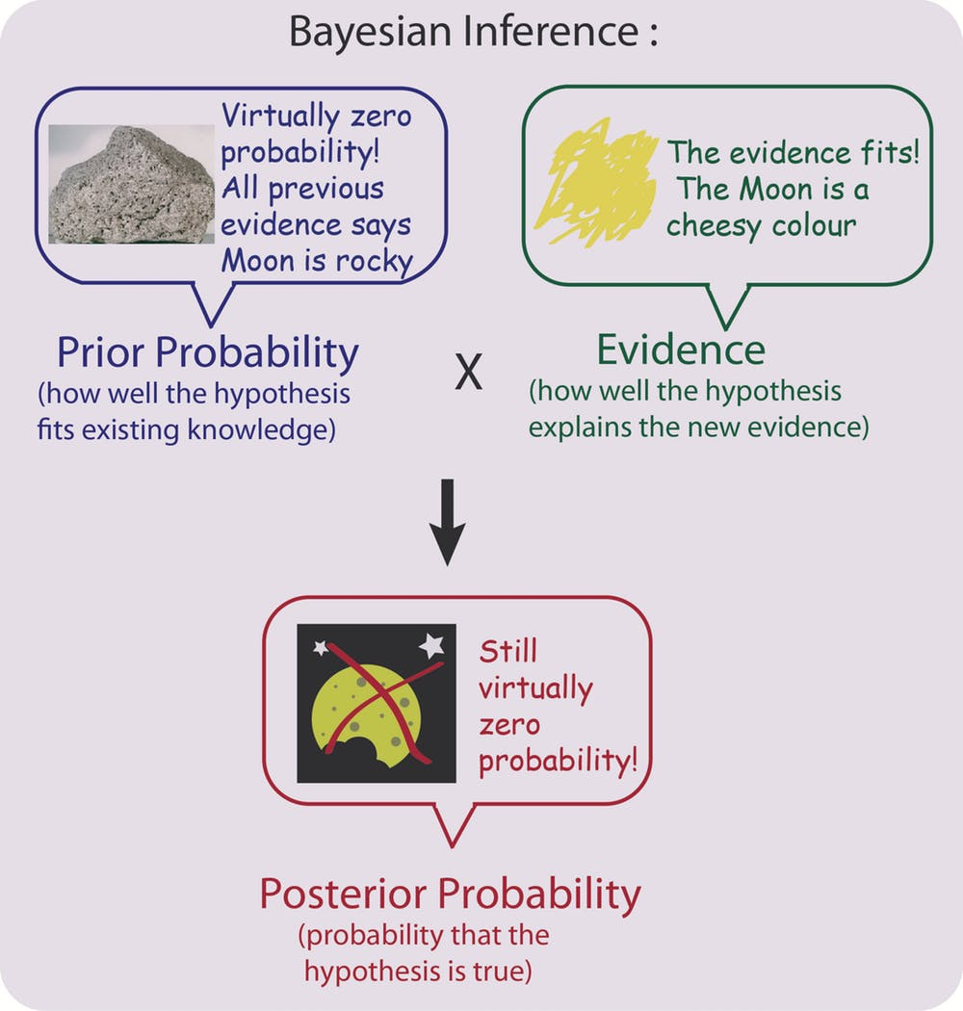
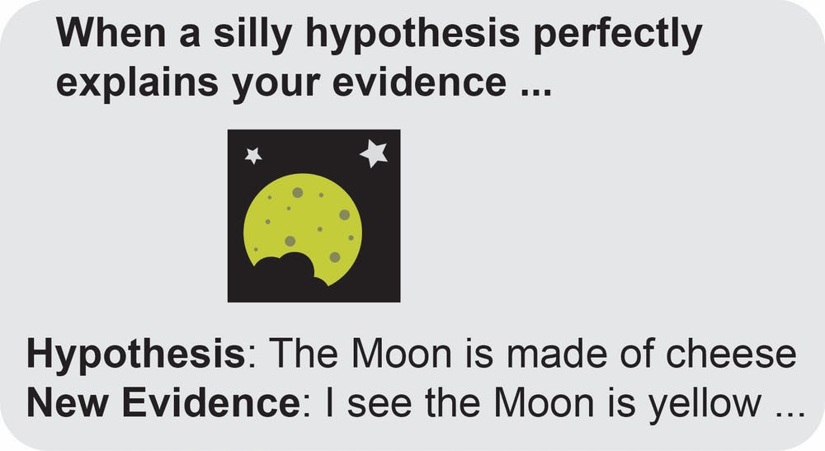
How does AI work: The Bayesians
The Bayesians focus on the probabilistic inference and Bayes' theorem to solve the problems. The Bayesians start with a belief that they call a prior. Then they obtain some data and update the prior on the basis of that data; the outcome is called a posterior. The posterior is then processed with more data and becomes a prior and this cycle repeats itself until we get the final answer. Most of the spam filters work on the same basis.
We use prior knowledge from our experiences and memories, and new evidence from our senses, to assign probabilities to everyday things and manage our lives.
SOURCE: https://theconversation.com/bayes-theorem-the-maths-tool-we-probably-use-every-day-but-what-is-it-76140

Slide 34
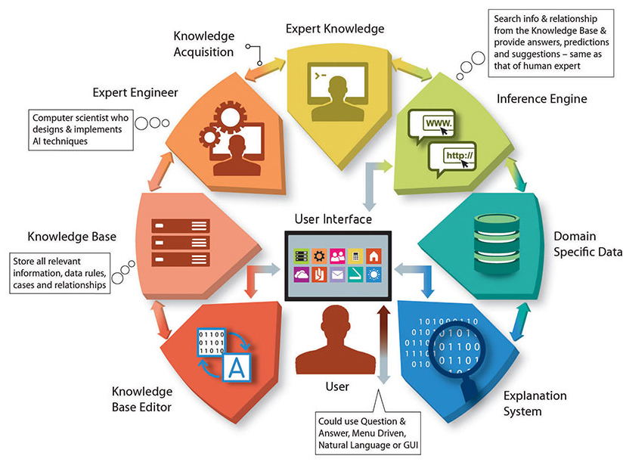
How does AI work: The Symbolists
The symbolists focus on philosophy and logic, and view learning as the inverse of deduction. The symbolists' approach solves the problem using pre-existing knowledge to fill the gaps. Most of the expert systems use the symbolists' approach to solve the problem with an If-Then approach.
Expert Systems are computer systems that imitate the decision-making capabilities of a human expert. They are intended to resolve complicated problems by reasoning about knowledge, delineated primarily as if–then rules rather than through traditional procedural code.
The need for symbolic techniques is getting a fresh wave of interest of late, with the recognition that for A.I. based systems to be accepted in certain high-risk domains, their behaviour needs to be verifiable and explainable. This is often very difficult to achieve by connectionist algorithms.
SOURCE: https://www.brandidea.com/expertsystems.html

Slide 35
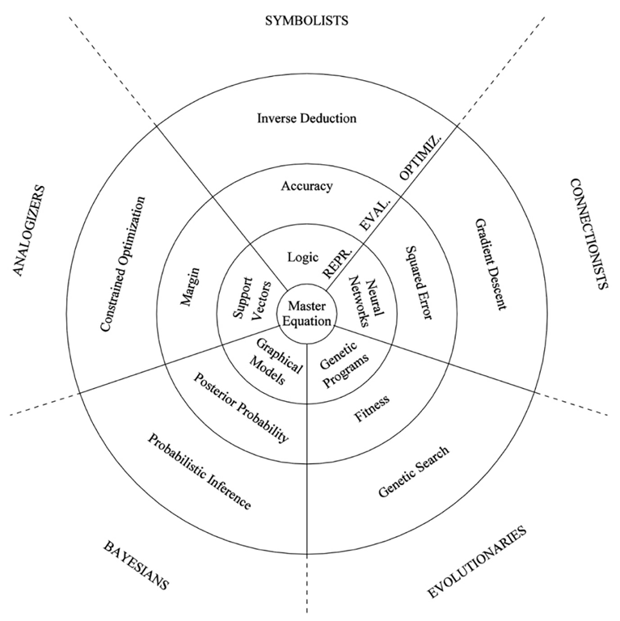
How does AI work: Common Framework
AI algorithms in all 5 ML schools of thought fit the same high-level pattern for learning algorithms: represent, evaluate, optimize. This is a useful framework for comparing and combining these different approaches to improve efficiency of practical real world applications of ML algorithms.
SOURCE: Pedro Domingos, The Master Algorithm 2015

Slide 36
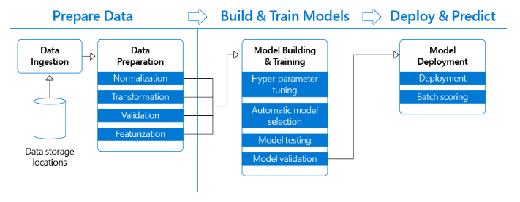
How does AI work: Standard ML Pipeline
All 5 ML schools of thought / approaches share approximately the same end-to-end process required to effectively use any machine learning algorithm in real life. This end-to-end process is called ML pipeline. It is an iterative workflow that includes 3 main stages: prepare data, build & train models, and deploy & predict.
SOURCE: Francesca Lazzari, Microsoft 2019

Slide 37
Part 4: How to Implement AI
Learning Outcomes:
At the end of this session students should be able to
Identify Key Ingredients for an AI Project.
Outline AI Project Activities.
Prepare AI Project Business Case.
Find Commercial Ready-to-Use AI products and services.
Select Software and other Resources for custom implementation of ML pipelines.
Select Computing infrastructure to host ML pipeline software.

Slide 38
How to Implement AI : Key Inputs and Outputs
Implementation of an ML pipeline is a software-intensive project that requires the following key ingredients: a business case, data, people, software, hardware. The project will use all these inputs to produce a working ML pipeline and the new, more efficient ways of working as the output.
Project Inputs
AI/ML Project
Project Outputs
Business Case
ML Pipeline
(Big) Data
Software
Hardware
New Ways of Working
People

Slide 39

How to Implement AI : Business Case
A typical project business case provides rationale why one should spend time and effort doing the project. It includes formulation of problems/opportunities that will be addressed, approximate approach to implementing the project, and estimated costs and benefits.
Matching what AI can do with value for business:
Identify business benefits of doing the project in terms of lowering operating costs, increasing revenue, offering new products and services to customers;
Using hard and soft AI limitations framework to assess AI applicability to achieving the identified business benefits.
Automating tasks, not jobs:
Use business analysis tools like process maps or workflow charts to break jobs into tasks,
Use “prediction machine” and “one second” intuitions to select tasks to be automated using AI.
What AI can do
What is useful

Slide 40
How to Implement AI : (Big) Data
Most ML projects need a lot of data to automatically learn and validate the correct algorithm. Different ML approaches (DL, SVM, …) require different amounts of data to achieve required accuracy.
What kind of data is required ?
It must be digital
Two implementation data sets: for training, and one for validation
The implementation data sets should have both input data and corresponding results
Make sure you have access to new data sets after the project is finished
How much data is enough?
Deep Learning (DL) approach requires really BID data : at least 10,000+ training examples
Some ML approaches (SVM, Bayesian) give reasonable results with 30+ training examples
Too much data is not always good: increased cost of data management, risk of “overfitting”
Where to get data?
Collect historical data yourself – may want to start data collection way before the project starts
Buy data from data providers
Auto-generate additional data by adding noise/distortions to existing data sets
Avoid the need for training data by outsourcing the whole training process.

Slide 41
How to Implement AI : Software
The type of software you need for an AI project depends on your “buy vs build” decision. If you decide to buy ready-made AI solutions then standard AI/ML offerings from major software companies is enough. If the nature of the problem you are trying to solve with AI requires more custom-made specialised solution then your project should use software development tools and building blocks to build your own ML pipeline.
Commercial Offerings for standard AI functions (buy instead of build):
Microsoft cognitive services: https://azure.microsoft.com/en-au/services/cognitive-services/
Amazon AWS AI services: https://aws.amazon.com/machine-learning/ai-services/
Google AI Cloud: https://cloud.google.com/products/ai/
IBM Watson: https://www.ibm.com/watson
Open-source ML frameworks to help you build your own ML pipeline:
TensorFlow,
PyTorch,
CNTK,
Keras,
MXNet,
R

Slide 42

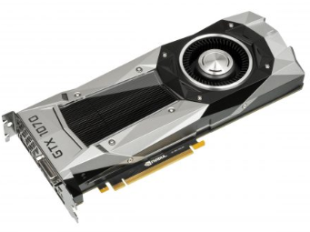
How to Implement AI : Hardware
If you decide to implement your own ML pipeline, then you need to buy or build your own hardware. As with any other custom software project you have 3 choices : use virtual hardware in the Cloud, buy your own computers, buy your own computers and keep them at your place. The selection depends on the scale and timeframes of your project.
Virtual Hardware in the Cloud (Infrastructure as a Service):
Microsoft Azure IaaS: https://azure.microsoft.com/en-us/overview/what-is-iaas/
Amazon AWS Elastic Compute Cloud: https://aws.amazon.com/ec2/
Google Compute Engine: https://cloud.google.com/compute
Buy your own computer:
CPU: Computer Processor (Central Processing Unit)
Computation is centralised – good for executing complex computations one-by-one.
Application: Symbolists AI (ES), Evolutionaries AI (GA)
GPU: Graphics Processing Unit
Computation is distributed – good for parallel executing many simple computations at the same time.
Applications: Connectionists AI (DL), Analogizers AI (SVM)

Slide 43
How to Implement AI : People
Skilled people are the most important input to an AI project. Different skills are required to implement an AI project including systems engineering, business analysis, data modelling, software development, hardware design, change management. It is possible that one person has all these skills. So small projects can be implemented with small number of multi-skilled people. The larger a project is the harder it is to keep a number of involved people low as even very skilled people have physical limitations. Coordination complexity increases as the number of involved people increases.
Business Analysts:
To formulate business pain points and identify business tasks for AI automation.
Data Modelers and Analysts:
To collect, understand, prepare and validate data.
Software Developers:
To design, build, configure, maintain software components of the ML pipeline.
Hardware Designers:
To design, build, configure, maintain hardware (virtual or physical) components of the ML pipeline.
Change Managers:
To implement changes to the business activities and org. structures required to start using the ML pipeline in the business and realise business benefits.

Slide 44
Part 5: AI Impacts
Learning Outcomes:
At the end of this session students should be able to
Discuss AI impact on Job Market.
Discuss business impacts of AI.
Discuss national and global impacts of AI.

Slide 45
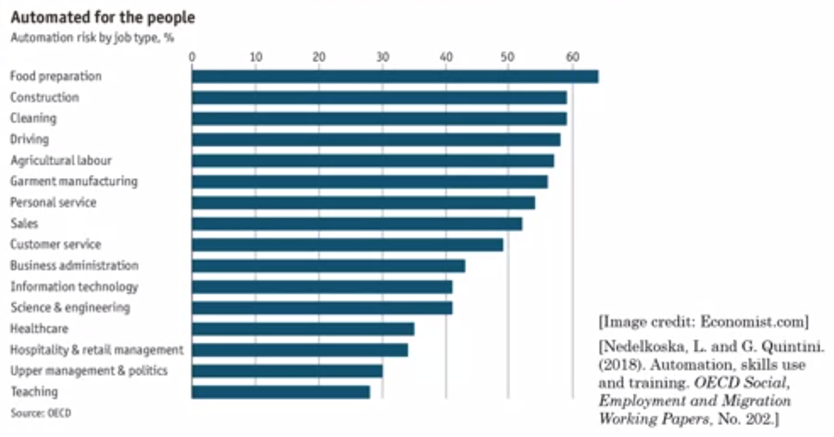
AI Impacts: AI and Jobs
AI will make different impacts on different jobs world-wide. The more structure, well-defined and repeatable a job type is the higher risk of full automation of this type of job by AI.

Slide 46
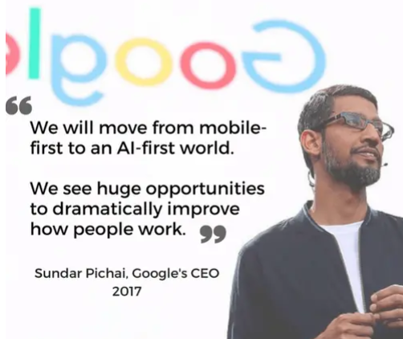
AI Impacts: AI and Business
“Just as electricity transformed almost everything 100 years ago, today I actually have a hard time thinking of an industry that I don’t think AI will transform in the next several years.”
- Andrew Ng
Importance and Scarcity of Data
For AI to be meaningful, companies need to feed their algorithms vast amounts of data, which isn’t always readily available. Some large companies launch products for the payout of data, not revenue, and then later monetize it through a different product.
AI-First Strategy
An AI-first strategy places maximizing prediction accuracy as the central goal of the organization, even if that means compromising on other goals such as maximizing revenue, user numbers, or user experience.
AI cab be disruptive for established companies
AI can lead to disruption because incumbent firms often have weaker economic incentives than start-ups to adopt the technology. It is tempting for established companies to take a wait-and-see approach, standing on the sidelines and observing the progress in AI applied to their industry.

Slide 47
AI Impacts: AI and Society
Broad adoption of AI technologies by different parts of Society brings both benefits and new challenges at national and global level. The technology uptake causes concerns related to ethics and fairness; the respect of human values, privacy, discrimination, national security.
The data privacy paradox:
For many AI systems, more training data can improve the accuracy of AI predictions and help reduce risk of bias from skewed samples. However, the more data collected, the greater the privacy risks to those whose data are collected.
Equitable and Inclusive Development:
AI may increase existing divides within and between developed and developing countries. These divides exist due to concentration of AI resources – AI technology, skills, datasets and computing power – in a few companies and nations.
Advancing Human Rights:
AI promises to advance the protection and fulfilment of human rights. Examples include using AI in the analysis of patterns in food scarcity to combat hunger, improving medical diagnosis and treatment or making health services more widely available and accessible, and shedding light on discrimination.
The New “Arm Race” for AI World Domination:
The US President Donald Trump signed an executive order creating the “American AI Initiative,” with which the US joined other major countries pursuing national strategies for AI. China released its “New Generation Plan” in 2017, outlining its strategy to lead the world in AI by 2030. Months after that announcement, Russian President Vladimir Putin declared, “Whoever becomes the leader in the sphere of AI will become the ruler of the world.”

